Slide 1



Optical Characterization setup
Kazuhiro Hotta

Slide 2
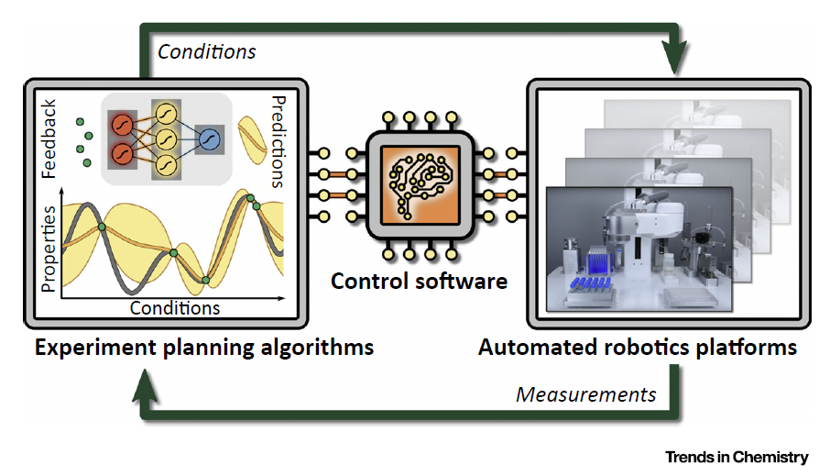
Self-driving laboratory
Property predictions
Experiment
AI algorisms
Quantum chemical
calculations
Automated
robotic platform
Accelerate the materials development by efficiently exploring huge and complex search spaces.
F. Häse et al., Trends in Chemistry 1, 282-291 (2019)

Slide 3

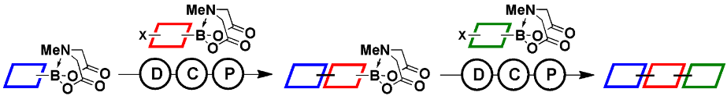
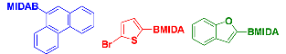
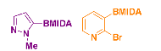

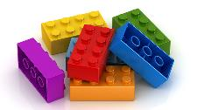
MADNESS Project
Accelerate the materials development by efficiently exploring the huge search space.
Automated Chemical synthesis system
LEGO like synthesis based on Suzuki-Miyaura coupling
...
AI-aided
experiment
planning
Define search space (building LEGO blocks)
High performance computing
for quantum-based simulations
- property prediction
- reaction condition prediction
Automated Characterization
Platform

Slide 4
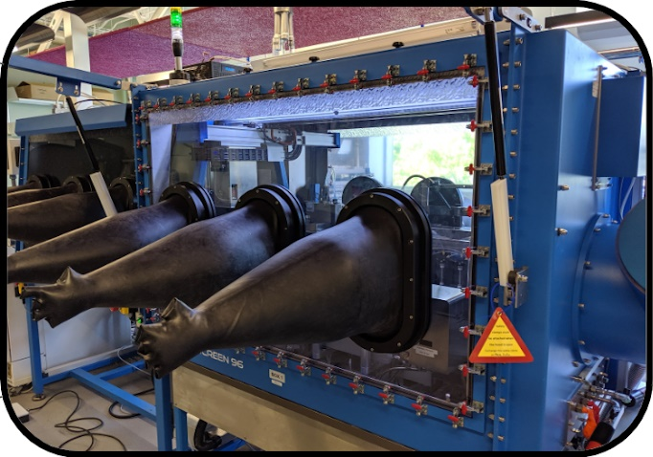
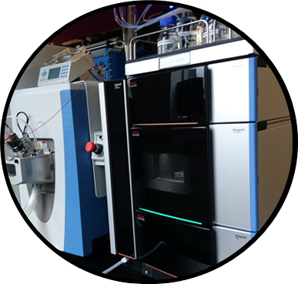
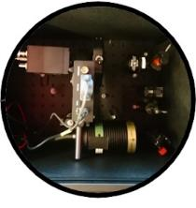
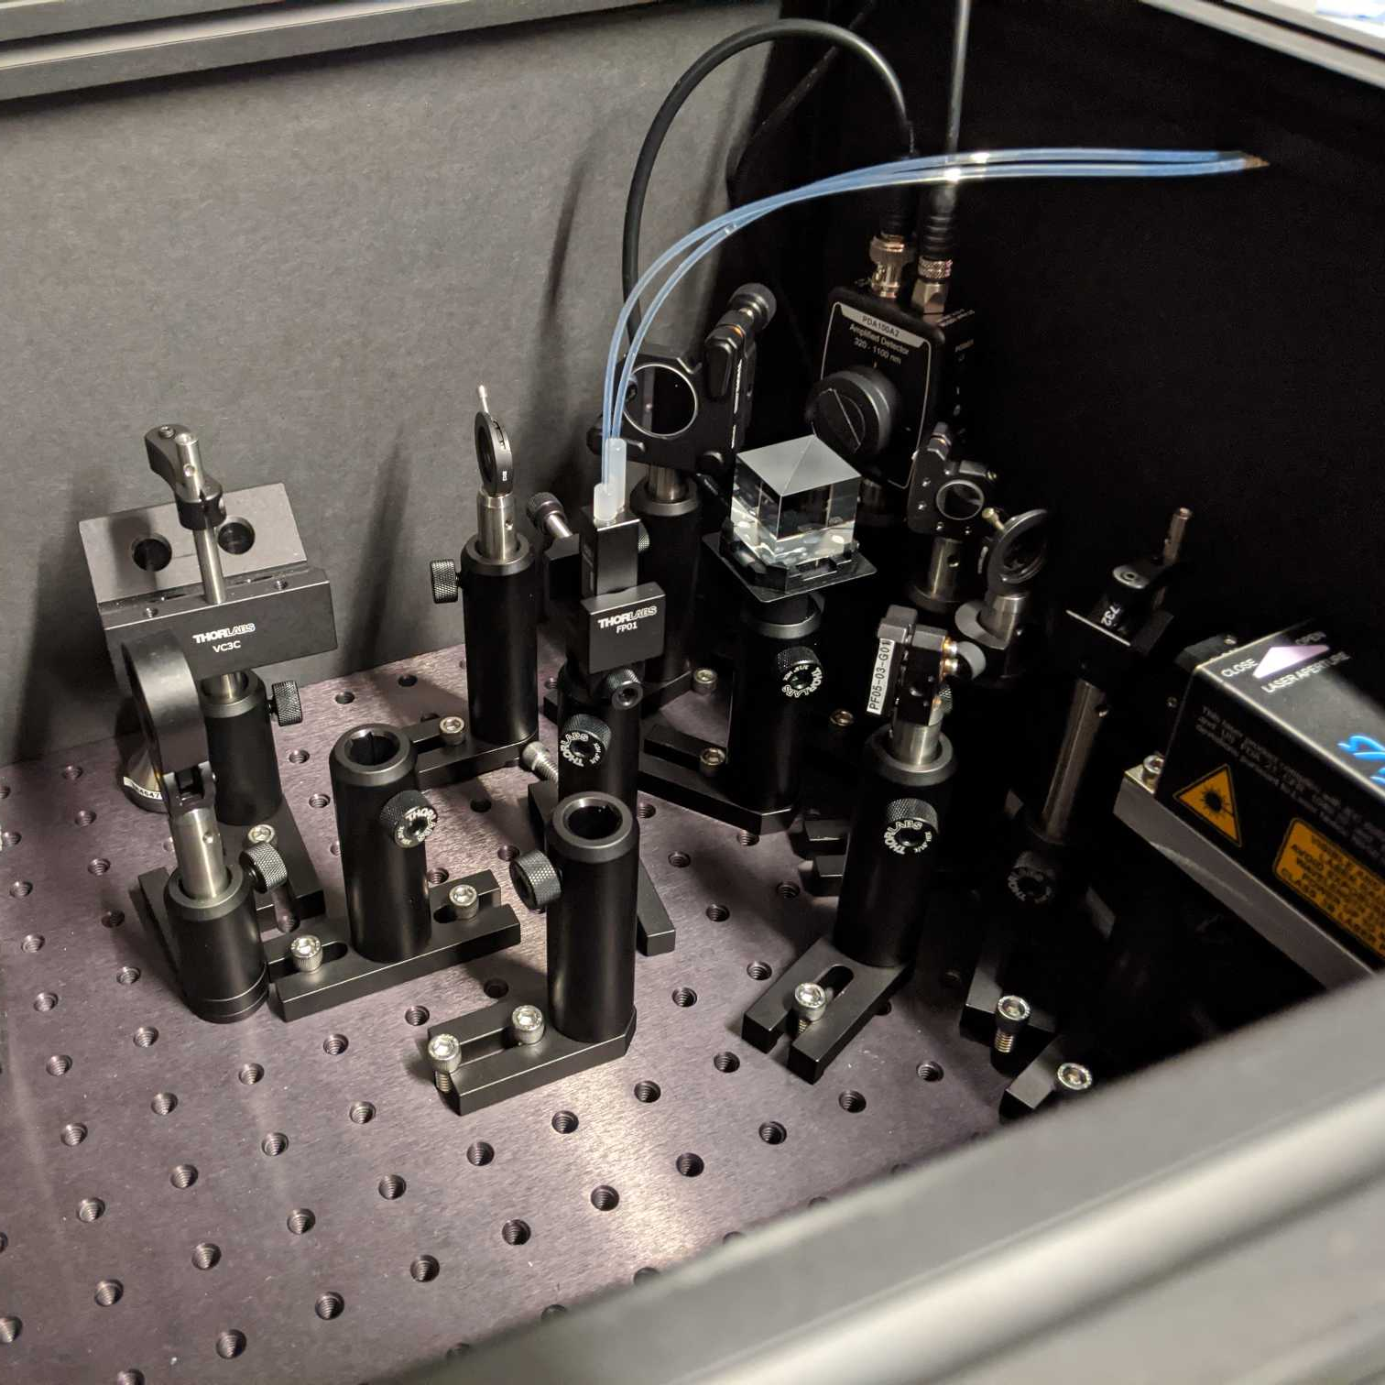
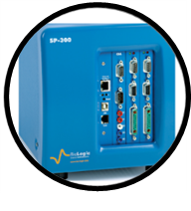
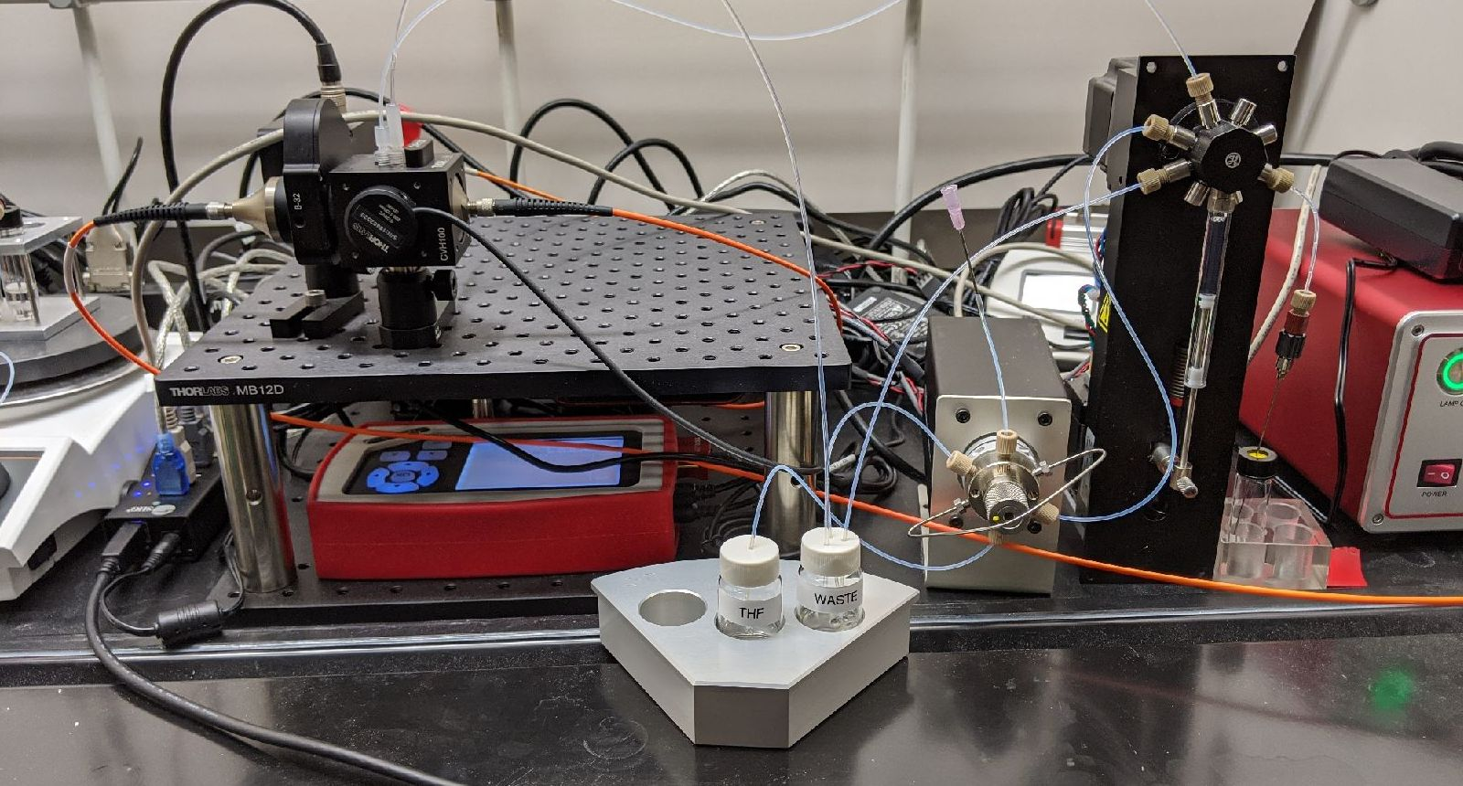
My task
Synthesis
Identification/separation
Characterization
Development of the automated characterization setups for the OLSD molecules
Integrating them with the automated synthesis and identification/separation platforms

Slide 5
Target properties for laser molecules

Slide 6
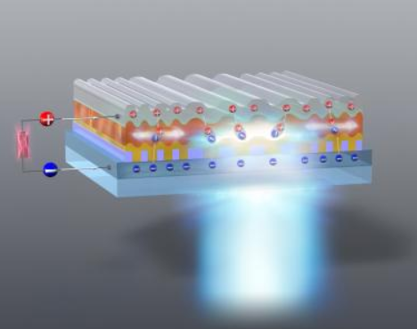
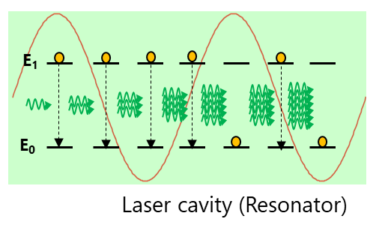
Target
~ Material for the organic semiconductor lasers ~
Light amplification in
the Laser cavity
Stimulated emission
Advantages over
inorganic lasers
Promising
applications
Technical difficulties
Low-cost fabrication
Solution processability
Mechanical flexibility
Wavelength tunability
Next Gen.
Communication
Heads up display
Thermo dynamic therapy
Triplet and polaron related losses
optical absorption
single-triplet annihilation
Degradation in the intense excitation
Low carrier mobility
A.S.D. Sandanayaka et al., Appl. Phys. Express 12, 061010 (2019)

Slide 7
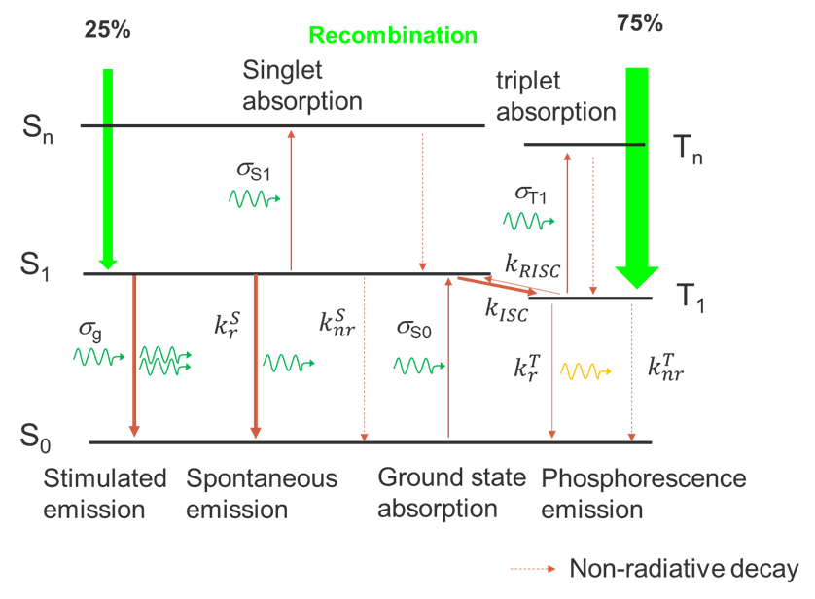
Dynamics in OSLD
Model of OSLD device architecture
Hole injection
Light confinement
Recombination
Electron injection
Light outcoupling
$$\frac{dS}{dt}=\left[Γσ_{g}N_{s1}−α_{cav}−Γ{(σ}_{s1}{N_{s1}+σ}_{t1}N_{t1} +σ_{p}N_{P})\right]\frac{c}{n_{eff}}S+β{k_{r}^{S}N}_{s1}$$
Photon
density
Cavity loss
Absorption losses
Spontaneous emission
Gain
Photon
flux

Slide 8
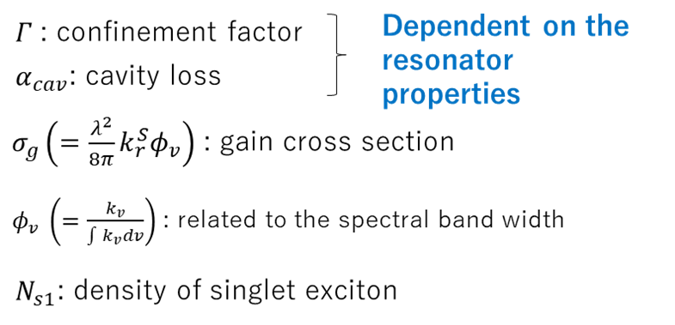
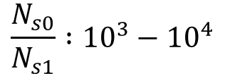
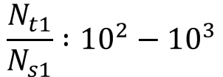
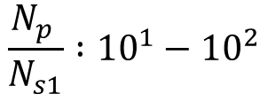
Target properties
Lasing condition
$Γσ_{g}N_{s1}>α_{cav}+Γ{(σ_{s0}N_{s0}+σ}_{s1}{N_{s1}+σ}_{t1}N_{t1} +σ_{p}N_{p}$)
Gain should be larger than the sum of all optical losses
High Gain
(large gain cross section and singlet population)
2. Small ground and excited state absorption at the emission wavelength
Estimated relative populations during lasing
Fast radiative decay
Narrow emission bandwidth
Large fluorescence quantum yield
Small probability of singlet related annihilations
Absorption cross section should be smaller than 𝝈_{g} in proportion to the relative populations

Slide 9
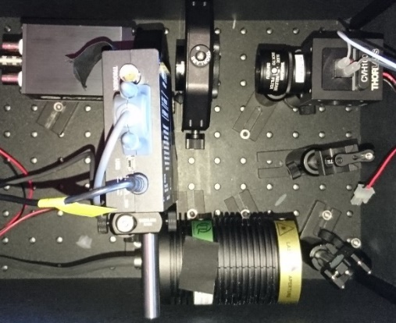
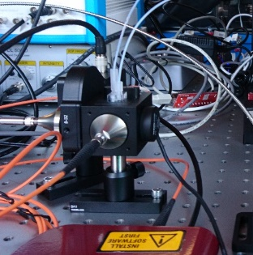
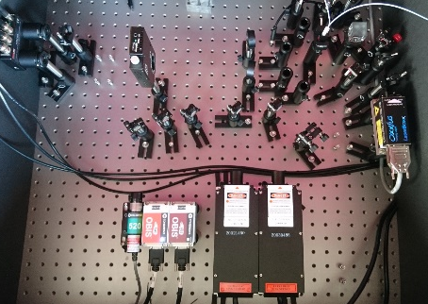
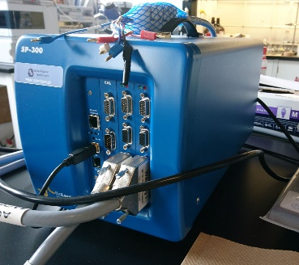
Progress in automated characterization setups
UV-VIS absorption/
Photoluminescence(PL)
Photoluminescence lifetime
Target property :
Target property :
- Emission band width
- Radiative decay constant
- Ground state Abs.
Development Status :
- PL quantum yield
Done
Development Status : Done
Triplet absorption
Spectro-electrochemistry
Target property :
Target property :
- Triplet absorption
- Charged state Abs.
Development Status :
Development Status :
- Prototyping was done
- Got potentiostat
- Implementing additional lasers
- Selecting spectrometer

Slide 10
Optical Characterization setups

Slide 11

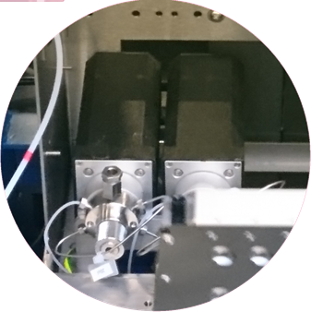
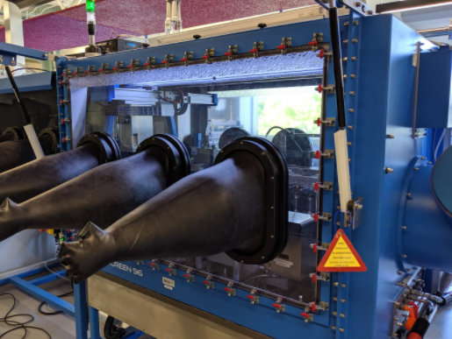
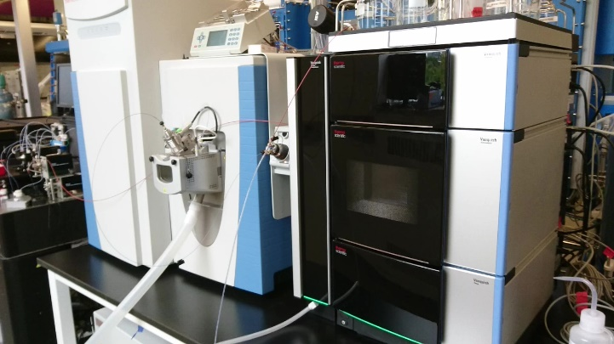

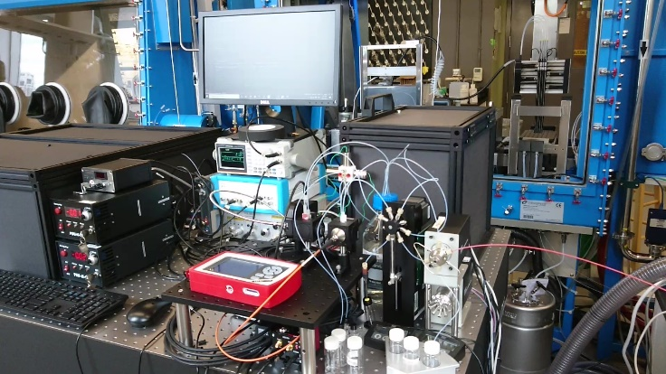
Communication workflow
Chemspeed
HPLC-MS
injection port
Reaction mixture
HPLC-MS job
HPLC-MS job
Sample collector
status
Dropbox
HPLC-MS
status
HPLC-MS/Sample collector status
Characterization job
Sample collector
status
Characterization job
Sample collector status
Characterization
setups
Purified reaction product

Slide 12
Current setup
HPLC-MS
Chemspeed
Waste
DAD
Inject
Waste
Column
MS
Pump
Syringe pump
PL lifetime
nitrogen
UV/VIS
Waste
Solvent
Waste
PL
Dilution vial
Collection Vials,
Heater/Chiller/Shaker

Slide 13
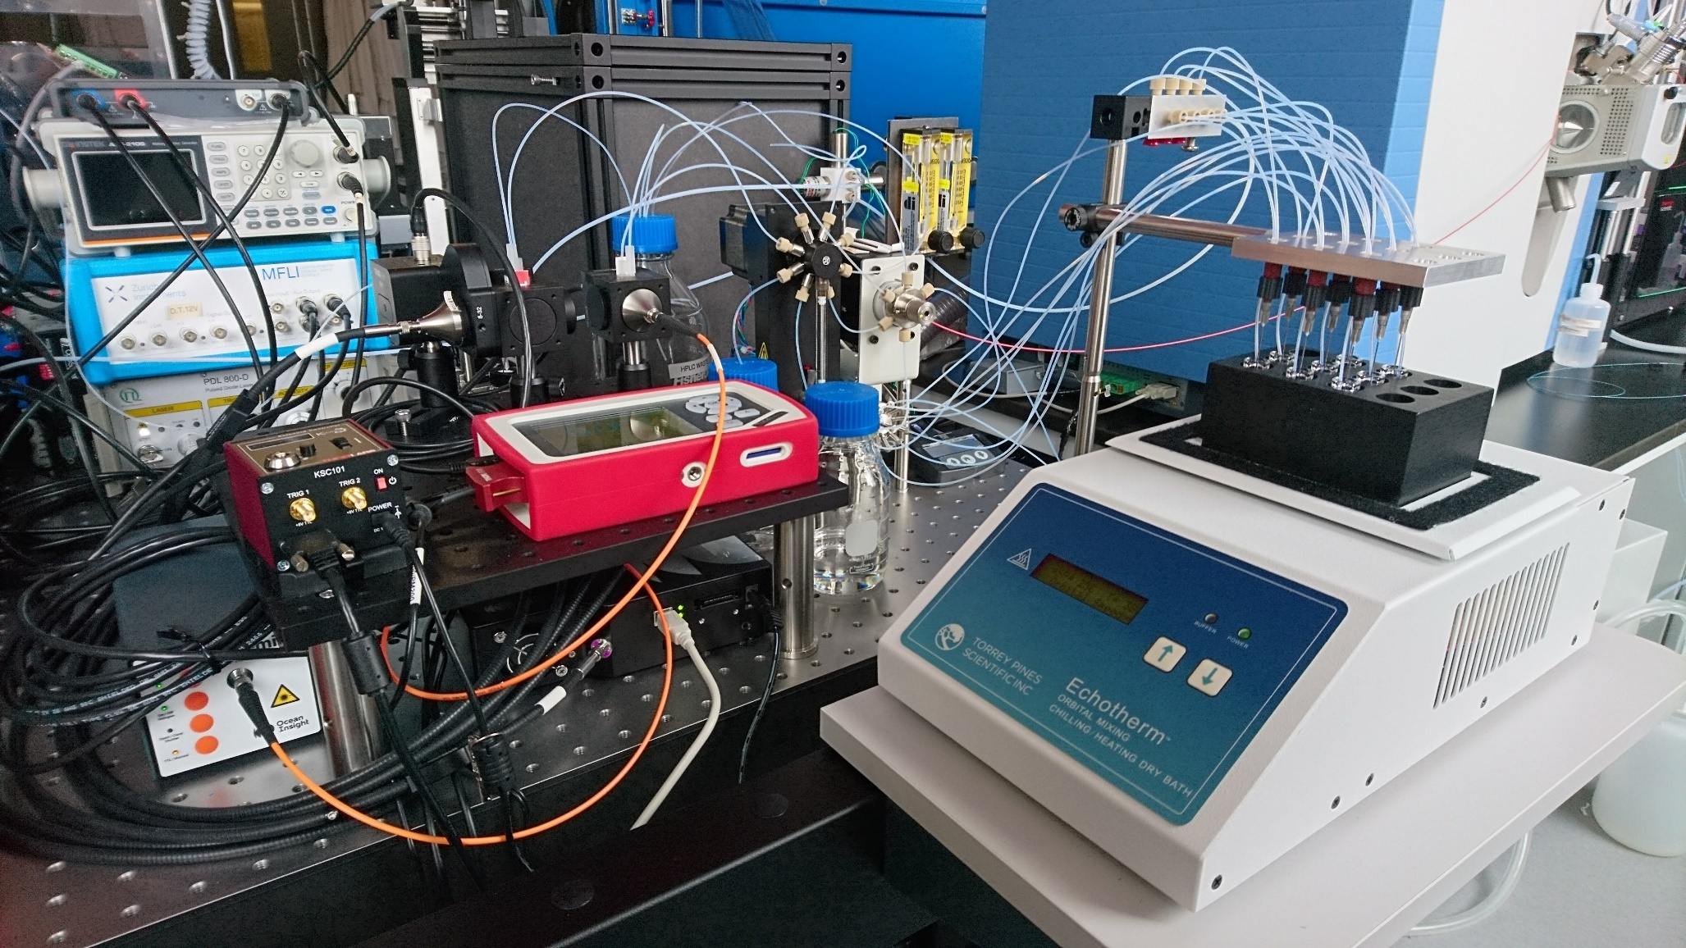
Optical setups
From
HPLC-MS
1 : Syringe pump
2 : 6-port valve
3 : flow splitter
4 : solvent bottle
5 : waste bottle
6 : UV/VIS absorption cell
7 : PL cell
8 : PL lifetime setup
9 : power meter
10 : spectrometer
11 : D₂/Halogen lamp
12 : shutter driver
13 : pico-second laser driver
14 : oscilloscope/function generator
15 : collection vials
16 : shaker/heater/chiller
(evaporation/redissolution unit)
14
8
17
5
1
7
6
2
13
9
3
15
12
4
11
10
16

Slide 14
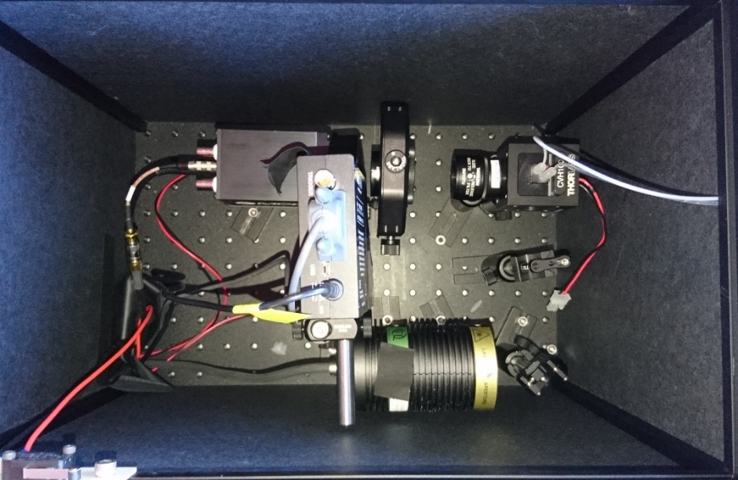
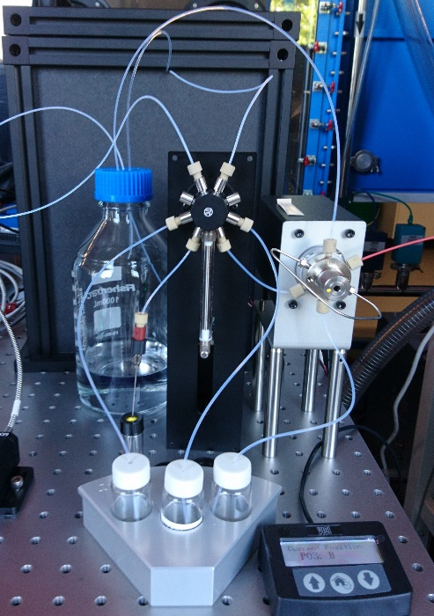
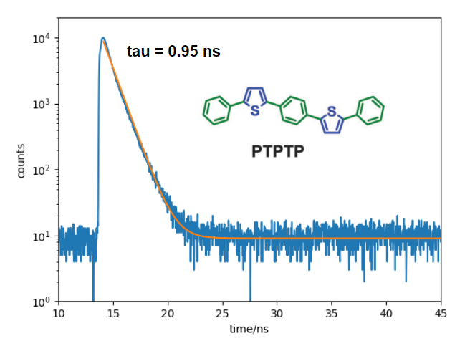
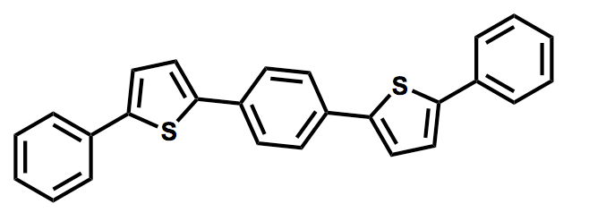
The PL lifetime measurement setup
Inside of the box
To
waste
To flow cell
APD
(detector)
lens
From
HPLC
Flow cell
lens
Sample
loop
ND filter
wheel
PTPTP
dilution
vial
solvent
mirror
Pico second laser
Fully automated measurement and data analysis
 | DSB* | PTPTP* | Rhodamine 6G | Rhodamine B
Our results (ns) | 1.29 ± 0.03 | 0.95 ± 0.03 | 3.95 ± 0.06 | 1.79 ± 0.09
Literature (ns) | 1.26 | 1.03 | 3.87 | 1.92
The flow cell is connected to the HPLC-MS
System response function : ca. 0.2 ns
Throughput : < 1 min/sample
* The error is 3𝛔 obtained from three measurements

Slide 15
Optical setups ~schematic diagram~
ND filter wheel
Waste
PL lifetime
cell
D₂/Halogen
lamp
APD
Spectrometer
Syringe pump
bandpass
filter
UV/VIS
cell
Waste
Driver
TCSPC
board
Pico second
Pulse laser
PL cell
Function
generator
P.M.
Solvent
Dilution
vial
shutter
nitrogen
LED
From
HPLC-MS
optical
fiber
Collection Vials,
Heater/Chiller/Shaker

Slide 16
Optical setups ~schematic diagram in detail ~
Solution line
LED driver
PC
Electrical
connection
Lamp
Controller
(USB GPIO)
TCSPC
board
Power meter
console
Waste
PL lifetime
cell
D₂/Halogen
lamp
Solvent
APD
Spectrometer
ND filter wheel
Syringe pump
bandpass
filter
UV/VIS
cell
Driver
Pico second
Pulse laser
PL cell
P.M.
Function
generator
Dilution
vial
flow
selector
Valve
driver
shutter
6-port
valve
N₂
LED
Shutter
driver
optical
fiber
Waste
From
HPLC-MS
Collection Vials,
Heater/Chiller/Shaker

Slide 17
Automated workflow (common for PL, Abs, TE)
1. and 2.
3-1.
air (or N₂)
3-2.
3-2.
air (or N₂)
4.
Initial state :
The sample solution is in the dilution vial
The flow cell is filled with a solvent (typically ACN)
5.
2. Dark (PL and Abs. ) and Reference (Abs. ) measurement:
Measure reference spectrum (after dark measurement with shutter close)
3. Sample transfer:
Send air to the cell to remove solvent from the cell*
Withdraw sample solution from the dilution vial and send it to the cell
5.
4. Sample measurement:
Measure sample spectrum (after dark measurement with shutter close)
5. Sample collection:
Collect sample from the cell and send it to the dilution vial for the following measurement**
* better not to withdraw solvent from the cell to prevent unintentional sample dilution due to the dead volume (~ 20 uL) of the syringe.
** cell washing is done only after all the measurements (PL, TE) finished for the same reason.

Slide 18
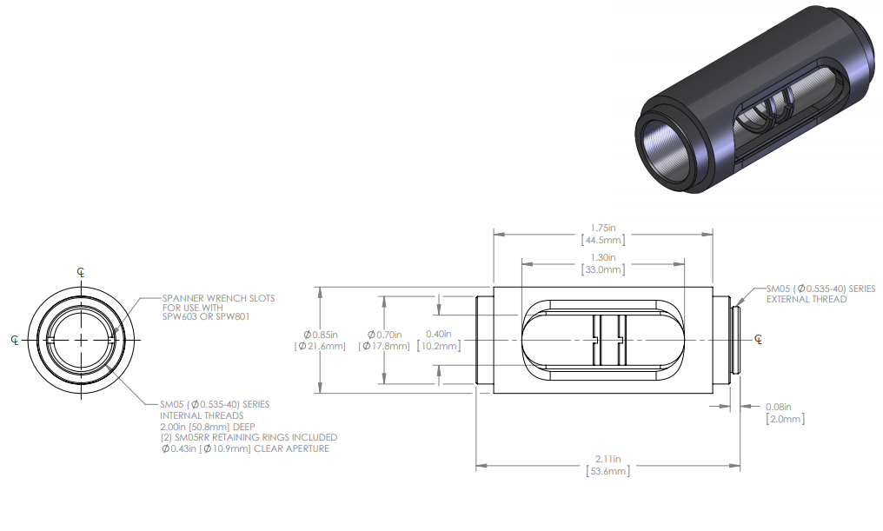
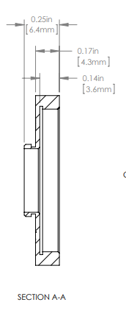
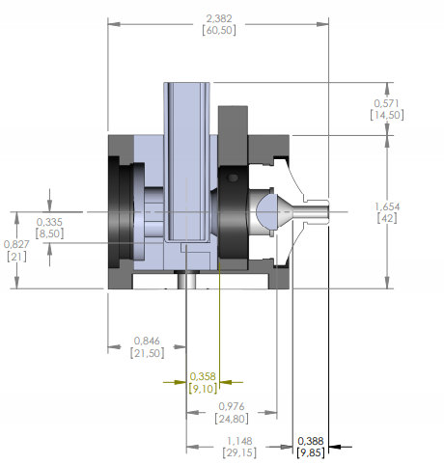
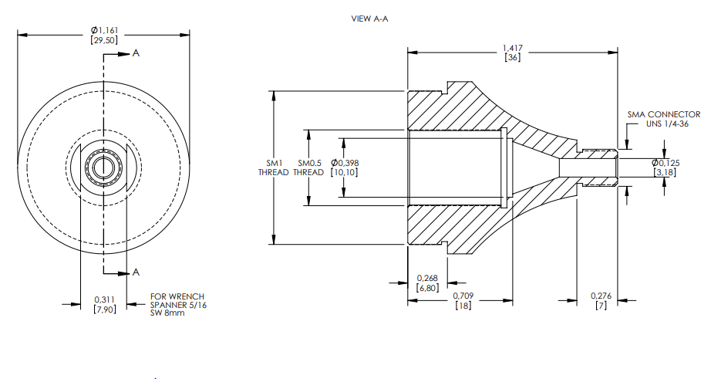
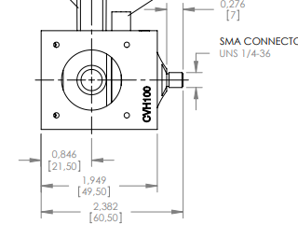
Fiber BF19Y2HS02
(φ = 0.8 mm, NA 0.22, θ = 12.7º)
24mm
51.6mm

Slide 19
Automation of the identification, purification and characterization workflow

Slide 20
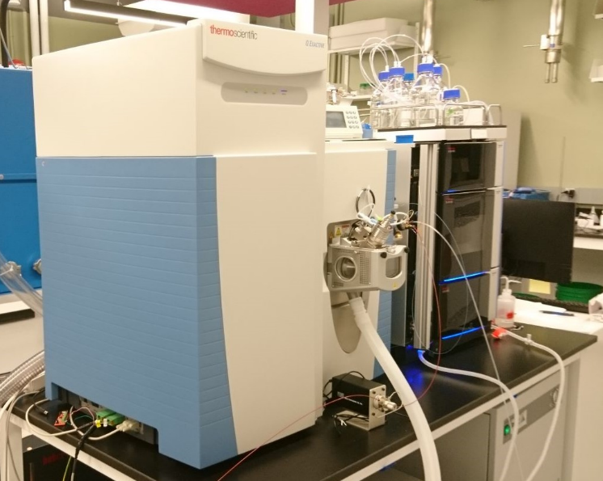
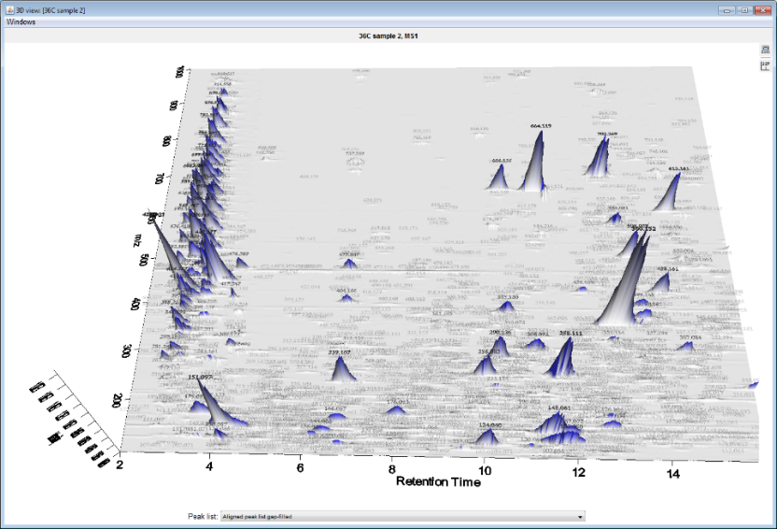
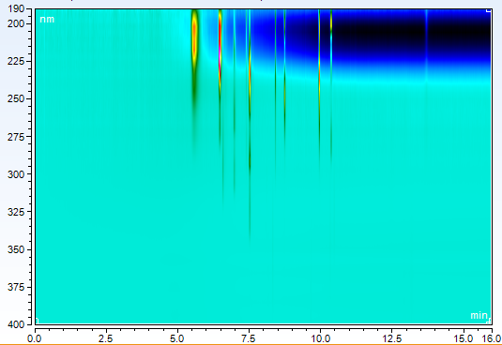
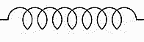
Sample identification/separation system based on the HPLC-MS
ThermoFisher HPLC-MS system
MS chromatogram*
absorbance chromatogram
200
250
m/z
Wavelength / nm
300
350
400
10.0
12.5
15.0
0.0
2.5
5.0
7.5
Retention Time / min
Retention Time / min
Chemspeed
UV-VIS
detector
Mass spec
pump
Waste
Column
(separation)
Crude reaction
mixture
Collection for characterization
(or to waste)

Slide 21
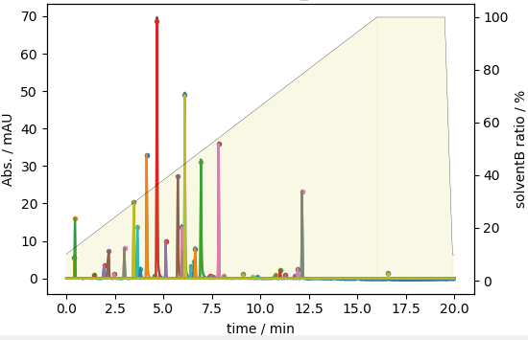

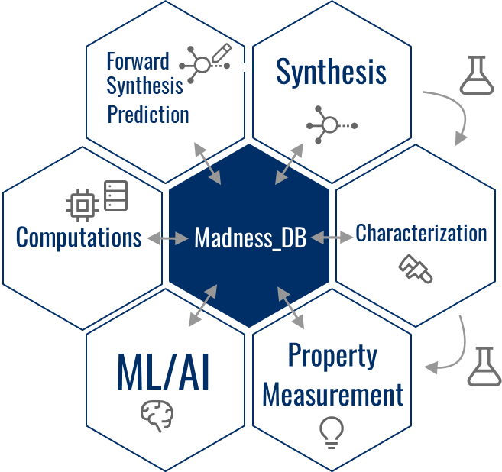
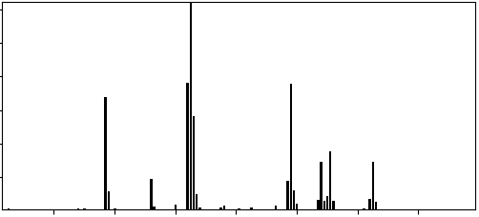
Software for the automation of HPLC-MS
Core
ThermoHPLCMS.py
Python package for the automated
HPLC-MS experiment
Modules
HPLC-MS control
/data access
Chromatogram analyzer
Instrument control
data analysis
interact with other devices
interact with the database
ThermoFisher
Chromeleon 7 SDK
Mass spec reader
/analyzer
Database interface
ThermoFisher
RawFileReader
MADNESS
DB**
Ion count
m/z
PythoMS*
* Yunker et al. J. Chem. Inf. Model. 2019, 59, 4, 1295–1300.

Slide 22
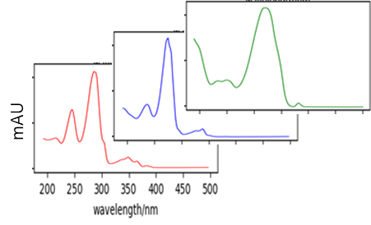
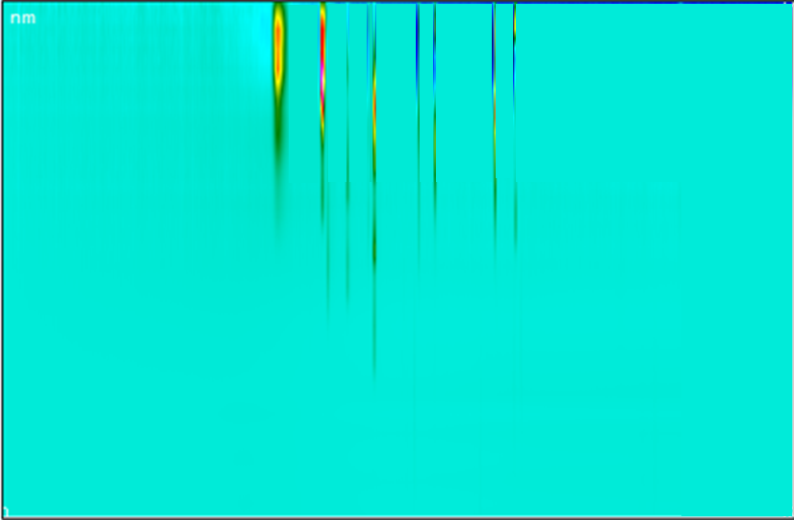
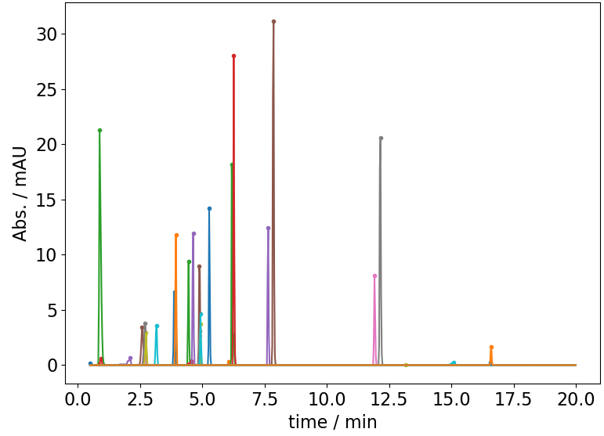
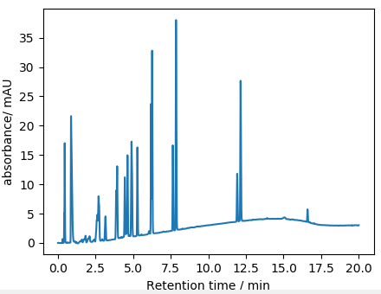
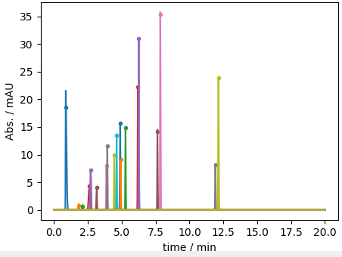
Automated peak analysis
Chromatograms and absorption spectra
for each component
Background
correction
200
250
3D Peak deconvolution
(MCR-ALS*)
Wavelength / nm
300
3D absorbance chromatogram
350
200
400
250
Time / min
Wavelength / nm
300
350
400
component 1 : r. time, peak area, …
component 2 : r. time, peak area, …
component 3 : r. time, peak area, …
:
Time / min
Collapse 3D
to 2D
2D/3D Peak deconvolution
for overlapping peaks
(MCR-ALS*, gaussian, exponentially modified gaussian, ..)
Background
Correction/
Peak detection
* Multivariate Curve Resolution-Alternating Least Squares
(M. M. Sinanian et al., Anal. Chem. 88, 11092−11099 (2016))

Slide 23
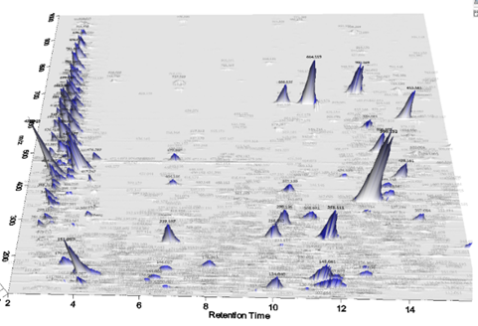
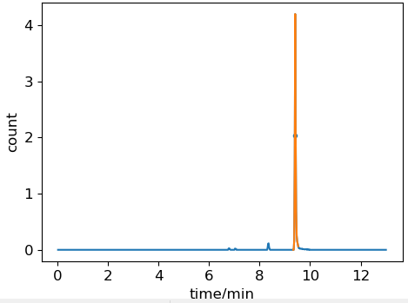

Peak identification in the targeted measurement
3D MS chromatogram*
Selected ion chromatogram (XIC)
at the M_{m} of the target
Isotope pattern confirmation
for the target
m/z
Retention Time / min
monoisotopic mass (Mm) of the target
to the characterization setups

Slide 24











Hardware configuraion
Synthesis
Identification/quantification/separation
Waste
Inject
Waste
Chemspeed
injection port
Flow
splitter
To HPLC
To optical setups
From HPLC
PL lifetime setup
Absorption flow cell
PL lifetime
Flow cell
Characterization
Syringe
pump
6-port
valve
Flow
selector
PL flow cell
6-port valve
PL
Flow cell
Waste
Syringe
pump
Flow
selector
From
HPLC-MS
Absorption
Flow cell
Vial for
dilution
Solvent
Waste
Collection vials
Solvent
Vials

Slide 25




Synthesis
Identification/quantification/separation
UV-vis absorption chromatogram
Waste
Inject
Waste
Flow
splitter
time / min
Selected ion chromatogram (XIC)
PL lifetime
Flow cell
Characterization
Syringe
pump
6-port
valve
Flow
selector
PL
Flow cell
Waste
time / min
Target identification based on the XIC
Absorption
Flow cell
Vial for
dilution
Retention time based multiple targets collection
Solvent
Waste
Collection vials
Parallel HPLC-MS and characterization

Slide 26



Characterization results
Absorption and PL spectrum
Absorption and PL spectrum
Time resolved PL intensity
Absorbance and PL time trace
DSB
DSB
BSBCz
BSBCz
Abs at 365nm (Dashed)
PL at λ_{em}
(solid)
wavelength / nm
time / ns
time / s
Photodegradation with O₂*
Throughput : About 10 minutes/sample including system washing
* For BSBCz, the double bonds are oxidized
and then broken

Slide 27




Requirement for the OSL molecules
Requirement for the laser
Gain should be larger than the sum of all optical losses
Absorbance/PL spectrum
Absorbance/Calculated spectral factor
Gain cross-section
Find the maximum in the region with no absorption
Spectral factor

Slide 28

Objective functions for the OSL molecules
Gain cross-section
Spectral factor
Spectral factor
(1E-24 cm² s)
Relative QY
1/PL lifetime
(1E9 s⁻¹)
PL Retention
(at 1 min)
*error bar : 3𝛔 of three measurements

Slide 29
Demonstration of the workflow

Slide 30

One-pot synthesis of BSBCz like molecules

Slide 31

Molecules to be tested

Slide 32

Automated synthesis and characterization workflow

Slide 33


Characterization results
…

Slide 34

Characterization results

Slide 35

Characterization results

